Slide 1
PROJECT
DIGITAL VOTING SYSTEM
PAIR
Muhammad Hamayun Farasat
and
Hafiz Muneeb Shahid
4.

Slide 2
Table of content
1.
Introduction
2.
Problem Statement and Functionality
3.
Outputs
4.
Future Work

Slide 3
Digital Voting System
1
Introduction
A digital voting system is an electronic platform that allows voters to cast their ballots using computers or smartphones, providing convenience and potentially faster results.
2
Convenience
Voters can vote from anywhere at any time, eliminating the need to visit a polling station.
3
Accuracy
Digital voting systems reduce errors in counting and minimize margins of human error.
4
Speed
The results will be available more quickly, which allows for faster announcements of election outcomes.

Slide 4
Problem Statement
The development of an electronic voting system program aims to address the persisting challenges and limitations associated with traditional paper-based voting methods. The current manual voting systems often suffer from inefficiencies, such as long waiting times, logistical complexities, errors in ballot counting, and potential instances of fraud or tampering. By creating an electronic voting system, we strive to enhance the integrity, accuracy, and accessibility of the voting process, ensuring secure and transparent elections while promoting efficient voter participation and trust in democratic procedures.

Slide 5
Functionality
1
Admin
Admin can login and have authority to start, stop voting and check result
2
Voter
Voter login and check his eligibility and cast vote if eligible.
3
Candidates
Candidates to which voter can vote.

Slide 6
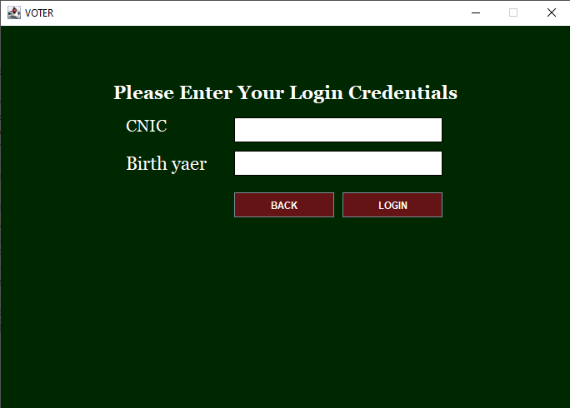
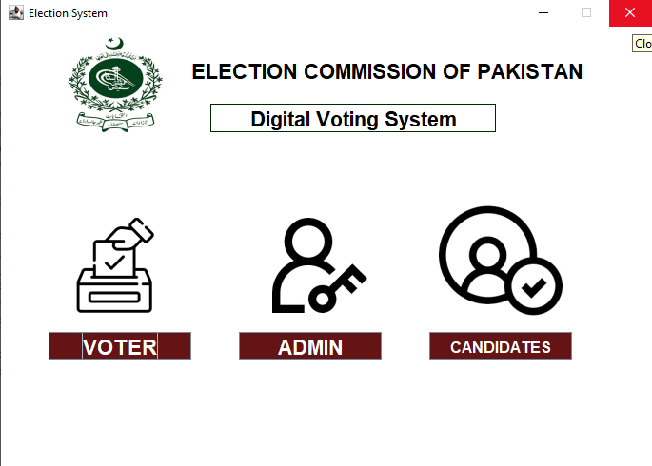

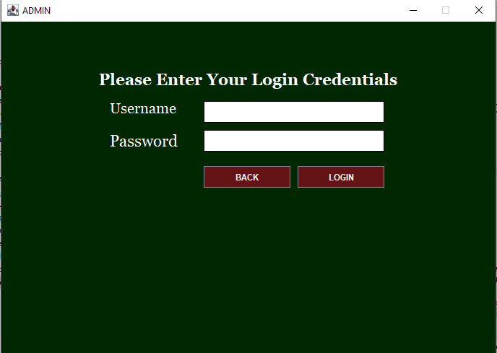
FLOW FROM MAIN WINDOW

Slide 7
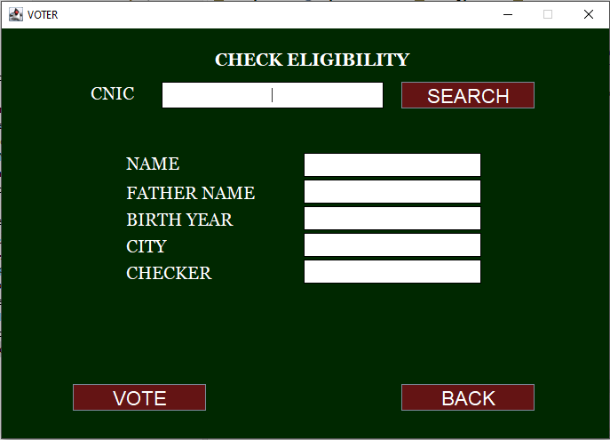

FLOW FROM VOTER WINDOW

Slide 8
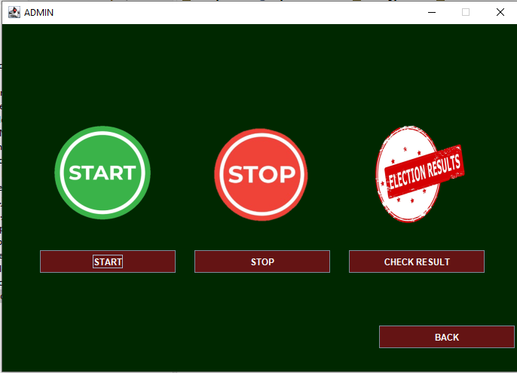
FLOW FROM ADMIN WINDOW

Slide 9


Future Work
Digital Signatures
Each vote is secured using authenticated digital signatures, ensuring it is genuine and original
Biometric Authentication
Uses facial recognition and/or thumbprints to authenticate voters and improve security.

